Slide 1

Schuläppli
Team Nightjet Enjoyers

Slide 2
Agenda
The Team
Demo
1
4
Our Solution
Techstack
2
3

Slide 3
Agenda
The Team
Demo
Our Solution
Techstack

Slide 4

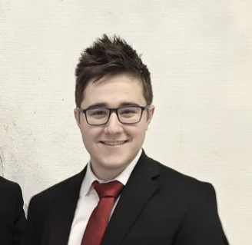

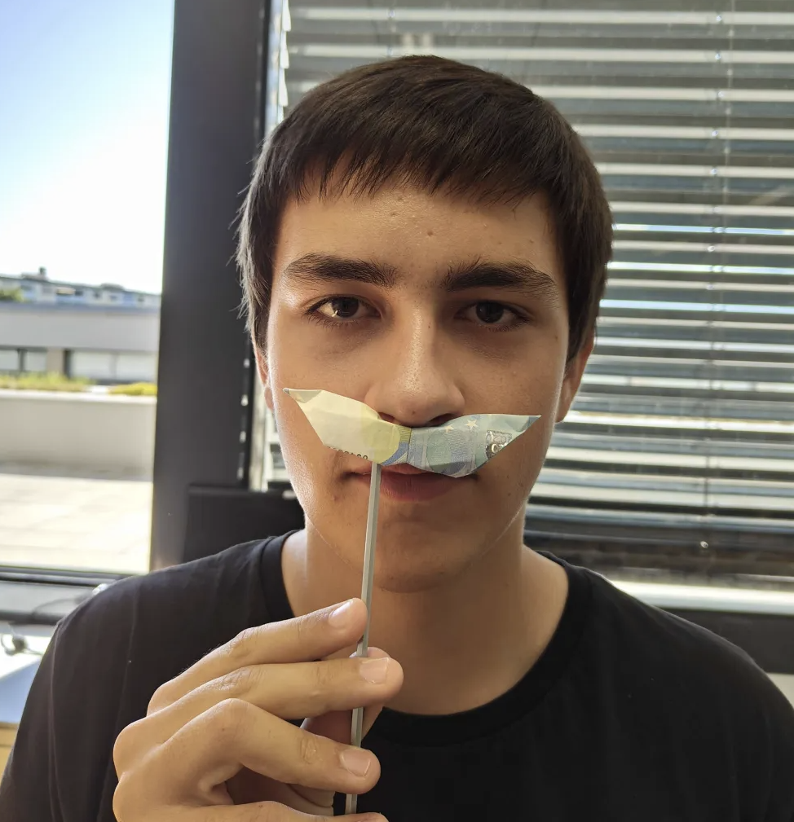
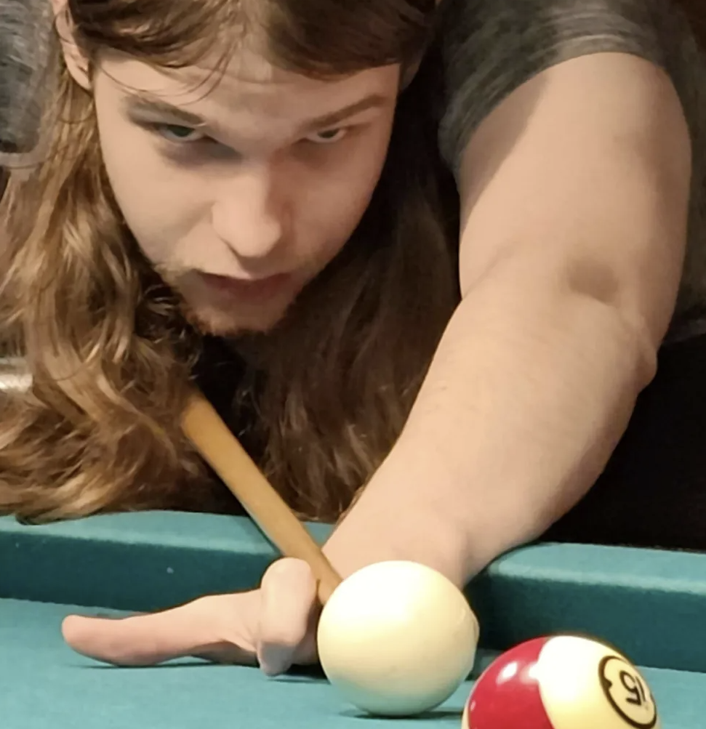
The Team
Pintér Adrián
Stettin Andreas
Kendlbacher Tobias
Backend Database
Schertler Markus
Management & Frontend
Full Stack
Backend Database

Slide 5
Our Solution
A beautiful web application to track students learning progress
Help teachers evaluate which competencies require more attention and increase quality of education in general
Set learning goals for students
Valuing the privacy of the children
Ease of use
Plan, Evaluate and Review

Slide 6
Plan, Evaluate and Review
Web App
Teachers
SATURN
MARS
MERCURY
Track Learning Progress
Evaluate competencies & increase quality of education
Set learning goals
Ease of use & Time efficiency
Protect childrens privacy

Slide 7








Techstack
Frontend
Backend
Docker
Keycloak
React
Tailwind
Astro
Node.js
Express
PostgreSQL
Containerisation & Authentication

Slide 8
Demo

Slide 9
Thank you very much for your attention!
Schuläppli
- An Äppli a day keeps the tutor away!
Team Nightjet Enjoyers

